Slide 1
Chatbot Music Recommendation System.
Team Details:
1.G Keerteshwar Reddy(20EG105410)
2.Mahesh Pawar(20EG105424)
3.Akhil D(20EG105716)
Project Supervisor
E.Radhakrishnaiah.

Slide 2
Introduction
The proposed system work develops a personalized system, where the user's current emotion is analyzed with the help of the chat bot.
The chat bot identifies the user's sentiment by chat conversation with the user.
Based on the input provided by the user, currentemotion or mood is analyzed by the chat bot and it will suggest song to the user.
The objective of our application is to identify the mood expressed by the user and once the mood is identified, songs are played by the application.
The application solves the basic needs of music listeners without troubling them as existing applications do.
Environment developed are Interactive Chat Bot, Interactive System User Interface, Recommender System, MYSQL Server,Natural Language Processing, Sentimental Analysis.

Slide 3
Literature
Author(s) | Method | Advantages | Disadvantages
J. B. Schafer, D. Frankowski, J. Herlocker, and S. Sen. | “Collaborative filtering recommender systems,” The Adaptive Web: Methods and Strategies of Web Personalization. | User-Based CF Approach and Item-based CF Approach. | Data Sparsity, Cold-star.
M. J. Pazzani and D. Billsus. | Content-based recommendation systems,” The Adaptive Web: Methods and Strategies ofWeb Personalization. | Based oncontext,Proposed system contains modules such as Intention Module, Mood Module and Recommendation Module each of which provide a unique functionality. | As the content increase trafficking of data increases leading to false adaptations.
W. Hsu, and C. J. Lin. | “A comparison of methods for multiclass support vector machines,”IEEE Tran. Neural Networks. | Multiple SVM combining each binary classification and all at once easily. | Computationally expensive when the dataset is large.
R. E. Fan, K. W. Chang, C. J. Hsieh, X. R. Wang, and C. J. Lin. | “LIBLINEAR: a library for large linear classification,” J. Machine Learning Research. | LIBLINEAR as an easy-to-use tool to deal with most promising learning techniques for large sparse data with a huge number of instances and features. | Has problems with saddle points and can't be parallelized over multiple processor cores.

Slide 4
Problem Statement
Recommendation of Music to the users based on their emotions during conversation or a word with a chatbot using Machine learning and Natural Language Processing.
Objective
The primary objectives of such a system are Personalization,Discovery,User Interaction,User Satisfaction.
Parameters are based on User Profile,Music Metadata,Collaborative Filtering,Content-Based Filtering,Recommendation Algorithms.

Slide 5
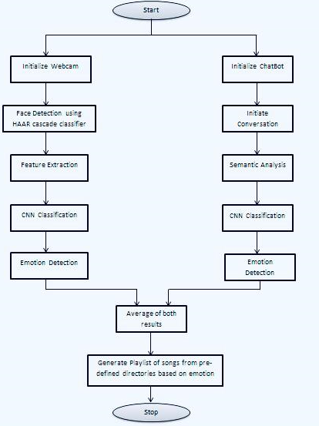
Proposed Method

Slide 6
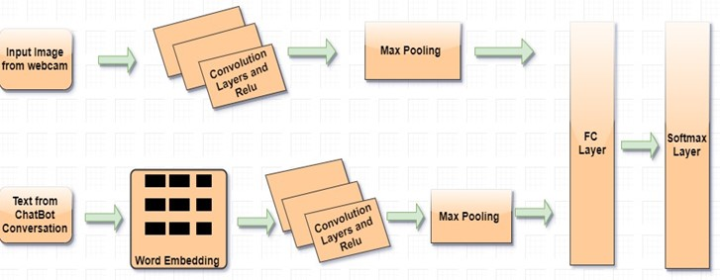
Proposed Method

Slide 7
Project status
S.No | Functionality | Status
1. | Design and flowchart | Completed
2. | Algorithm selection | Completed
3. | Data Acquisition and Integration | Completed
4. | Data Preprocessing | Completed
5. | Model development | In Progress
6. | Model evaluation | Not Yet Started
7. | Maintenance | Not Yet Started

Slide 8
References
Emotion aware Smart Music Recommender System using Two Level CNN
(Proceedings of the Third International Conference on Smart Systems and Inventive Technology (ICSSIT 2020) IEEE Xplore Part Number: CFP20P17-ART).
A Machine Learning Based Chatbot Song Recommender System(IRJMETS-e-ISSN: 2582-5208).

Slide 9

_G
-GROUP 7.

